Slide 1

Module-I Defining artificial intelligence
Prepared by: Dr. Ram Paul Hathwal
Dept of CSE, ASET, AUUP

Slide 2
Outlines
Course Learning Outcomes
What is AI?
What is Intelligence?
Physical Symbol System
Symbol Ground
The Turing Machine
Brain vs Computer
Two AI Assumptions
AI History

Slide 3
Course Learning Outcomes
At the end of this course:
Knowledge and understanding You should have a knowledge and understanding of the basic concepts of Artificial Intelligence including Search, Game Playing, Planning and Machine Learning.
Intellectual skills You should be able to use this knowledge and understanding of appropriate principles and guidelines to synthesise solutions to tasks in AI and to critically evaluate alternatives.
Practical skills You should be able to use a well known declarative language (Python) and to construct simple AI systems.
Transferable Skills You should be able to solve problems and evaluate outcomes and alternatives.

Slide 4
Data, Information, Knowledge and Intelligence
Data: Data is not a set of raw facts but it is the collection of meaningful symbols.
Information: It is a meaningful, shareable pattern or formatted data that collectively carries a logical meaning.
Knowledge: Knowledge is information that has been retained with an understanding about the significance of that information.
Intelligence: Unlike belief and knowledge, intelligence is not information: it is a process, or an innate capacity to adapt and learn that has been accumulated throughout our species’ development.

Slide 5
What is Intelligence?
Is there a “holistic” definition for intelligence?
Here are some definitions:
the ability to comprehend; to understand and profit from experience
a general mental capability that involves the ability to reason, plan, solve problems, think abstractly, comprehend ideas and language, and learn
is effectively perceiving, interpreting and responding to the environment
None of these tells us what intelligence is, so instead, maybe we can enumerate a list of elements that an intelligence must be able to perform:
perceive, reason and infer, solve problems, learn and adapt, apply common sense, apply analogy, recall, apply intuition, reach emotional states, achieve self-awareness.
Artificial Intelligence – should we define this in terms of human intelligence?
does AI have to really be intelligent?
what is the difference between being intelligent and demonstrating intelligent behavior?

Slide 6
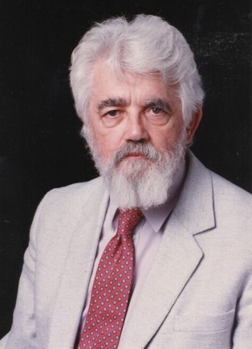
AI Definitions
According to the father of AI, John McCarthy, it is “The science and engineering
of making intelligent machines, especially intelligent computer programs”.
The study of how to make computers solve problems which require knowledge and intelligence
The exciting new effort to make computers think … machines with minds
The automation of activities that we associate with human thinking (e.g., decision-making, learning…)
The art of creating machines that perform functions that require intelligence when performed by people
A field of study that seeks to explain and emulate intelligent behavior in terms of computational processes
The branch of computer science that is concerned with the automation of intelligent behavior.
AI is the part of computer science concerned with design of computer systems that exhibit human intelligence (From the Concise Oxford Dictionary).

Slide 7
So What is AI?
AI as a field of study:
Computer Science: applies the principles of mathematics, engineering, and logics as functions.
Cognitive Science: the interdisciplinary scientific investigation of the mind and intelligence.
Psychology: the interdisciplinary scientific investigation of the mind and intelligence
Philosophy: is the study of the fundamental nature of knowledge, reality, and existence.
Linguistics: is a study of the origins of language and of how language evolved.
Neuroscience: is the scientific study of the nervous system.
AI often must study other domains in order to implement systems:
e.g., medicine and medical practices for a medical diagnostic system, engineering and chemistry to monitor a chemical processing plant
AI is a belief that the brain is a form of biological computer and that the mind is computational
AI has had a concrete impact on society but unlike other areas of CS, the impact is often
felt only tangentially (that is, people are not aware that system X has AI)
felt years after the initial investment in the technology

Slide 8
Vision of AI
Systems that think like humans.
Systems that act like humans.
Systems that think rationally.
Systems that act rationally.
A distinction between being intelligent and acting intelligently, and being like a human, or solving similar problems (not necessarily the same way).
Through a set of experiments and computational models, trying to build good explanations of what we do when we solve a particular task.
Relevance to AI: to solve a problem that humans (or other living being) are capable of, it's good to know how we go about solving it.

Slide 9
Computers Solve Problems
We can clearly see that computers solve problems in a seemingly intelligent way:
Where is the intelligence coming from?
There are numerous responses to Searle’s argument:
The System’s Response:
the hardware by itself is not intelligent, but a combination of the hardware, software and storage is intelligent.
in a similar vein, we might say that a human brain that has had no opportunity to learn anything cannot be intelligent, it is just the hardware
The Robot Response:
a computer is void of senses and therefore symbols are meaningless to it, but a robot with sensors can tie its symbols to its senses and thus understand symbols
The Brain Simulator Response:
if we program a computer to mimic the brain (e.g., with a neural network) then the computer will have the same ability to understand as a human brain

Slide 10
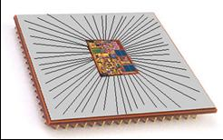
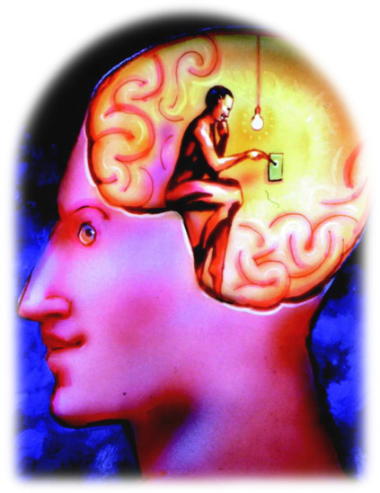
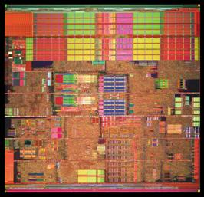
Brain vs. Computer
In AI, we compare the brain (or the mind) and the computer
Our hope: the brain is a form of computer
Our goal: we can create computer intelligence through programming just as people become intelligent by learning
But we see that the computer is not like the brain
The computer performs tasks without understanding what its doing
Does the brain understand what its doing when it solves problems?

Slide 11
Symbol Grounding
One problem with the computer is that it works strictly syntactically
Op-code: 10011101 → translates into a set of microcode instructions such as: move IR_{16..31} to MAR, signal memory read, move MBR to AC
There is no understanding
x = y + z; is meaningless to the computer
the computer doesn’t understand addition, it just knows that a certain op-code means to move values to the adder and move the result elsewhere
do you know what addition means?
if so, how do you proscribe meaning to +
how is this symbol grounded in your brain?
Recall Schank’s Restaurant script
does the computer know what the symbols “waiter” or “Others” represent? or does it merely have code that tells the computer what to do when it comes across certain words in the story, or how to respond to a given question?

Slide 12
Two AI Assumptions
We can understand and model cognition without understanding the underlying mechanism
That is, it is the model of cognition that is important not the physical mechanism that implements it
If this is true, then we should be able to create cognition (mind) out of a computer or a brain or even other entities that can compute such as a mechanical device
This is the assumption made by symbolic AI researchers
Cognition will emerge from the proper mechanism
That is, the right device, fed with the right inputs, can learn and perform the problem solving that we, as observers, call intelligence
Cognition will arise as the result (or side effect) of the hardware
This is the assumption made by connectionist AI researchers
Notice that while the two assumptions differ, neither is necessarily mutually exclusive and both support the idea that cognition is computational

Slide 13
Problems with Symbolic AI Approaches
Scalability
It can take dozens or more man-years to create a useful systems
It is often the case that systems perform well up to a certain threshold of knowledge (approx. 10,000 rules), after which performance (accuracy and efficiency) degrade
Brittleness
Most symbolic AI systems are programmed to solve a specific problem, move away from that domain area and the system’s accuracy drops rapidly rather than achieving a graceful degradation
this is often attributed to lack of common sense, but in truth, it is a lack of any knowledge outside of the domain area
No or little capacity to learn, so performance (accuracy) is static
Lack of real-time performance

Slide 14
Problems with Connectionist AI Approaches
No “memory” or sense of temporality
The first problem can be solved to some extent
The second problem arises because of a fixed sized input but leads to poor performance in areas like speech recognition
Learning is problematic
Learning times can greatly vary
Overtraining leads to a system that only performs well on the training set and undertraining leads to a system that has not generalized
No explicit knowledge-base
So there is no way to tell what a system truly knows or how it knows something
No capacity to explain its output
Explanation is often useful in an AI system so that the user can trust the system’s answer

Slide 15
So What does AI Do?
Most AI research has fallen into one of two categories
Select a specific problem to solve
study the problem (perhaps how humans solve it)
come up with the proper representation for any knowledge needed to solve the problem
acquire and codify that knowledge
build a problem solving system
Select a category of problem or cognitive activity (e.g., learning, natural language understanding)
theorize a way to solve the given problem
build systems based on the model behind your theory as experiments
modify as needed
Both approaches require
one or more representational forms for the knowledge
some way to select proper knowledge, that is, search

Slide 16
A Brief History of AI: 1950s
Computers were thought of as an electronic brains
Term “Artificial Intelligence” coined by John McCarthy
John McCarthy also created Lisp in the late 1950s
Alan Turing defines intelligence as passing the Imitation Game (Turing Test)
AI research largely revolves around toy domains
Computers of the era didn’t have enough power or memory to solve useful problems
Problems being researched include
games (e.g., checkers)
primitive machine translation
blocks world (planning and natural language understanding within the toy domain)
early neural networks researched: the perceptron
automated theorem proving and mathematics problem solving

Slide 17
The 1960s
AI attempts to move beyond toy domains
Syntactic knowledge alone does not work, domain knowledge required
Early machine translation could translate English to Russian (“the spirit is willing but the flesh is weak” becomes “the vodka is good but the meat is spoiled”)
Earliest expert system created: Dendral
Perceptron research comes to a grinding halt when it is proved that a perceptron cannot learn the XOR operator
US sponsored research into AI targets specific areas – not including machine translation
Weizenbaum creates Eliza to demonstrate the futility of AI

Slide 18
1970s
AI researchers address real-world problems and solutions through expert (knowledge-based) systems
Medical diagnosis
Speech recognition
Planning
Design
Uncertainty handling implemented
Fuzzy logic
Certainty factors
Bayesian probabilities
AI begins to get noticed due to these successes
AI research increased
AI labs sprouting up everywhere
AI shells (tools) created
AI machines available for Lisp programming
Criticism: AI systems are too brittle, AI systems take too much time and effort to create, AI systems do not learn

Slide 19
1980s: AI Winter
Funding dries up leading to the AI Winter
Too many expectations were not met
Expert systems took too long to develop, too much money to invest, the results did not pay off
Neural Networks to the rescue!
Expert systems took programming, and took dozens of man-years of efforts to develop, but if we could get the computer to learn how to solve the problem…
Multi-layered back-propagation networks got around the problems of perceptrons
Neural network research heavily funded because it promised to solve the problems that symbolic AI could not
By 1990, funding for neural network research was slowly disappearing as well
Neural networks had their own problems and largely could not solve a majority of the AI problems being investigated
Panic! How can AI continue without funding?

Slide 20
1990s: A Life
The dumbest smart thing you can do is staying alive
We start over – lets not create intelligence, lets just create “life” and slowly build towards intelligence
Alife is the lower bound of AI
A life includes
evolutionary learning techniques (genetic algorithms)
artificial neural networks for additional forms of learning
perception and motor control
adaptive systems
modeling the environment
Let’s disguise AI as something new, maybe we’ll get some funding that way!
Problems: genetic algorithms are useful in solving some optimization problems and some search-based problems, but not very useful for expert problems
perceptual problems are among the most difficult being solved, very slow progress

Slide 21
Today: The New (Old) AI
By their own admission, AI researchers are not doing “AI”, they are doing
Intelligent agents, multi-agent systems/collaboration
Machine learning and data mining
Adaptive and perceptual systems
Robotics, path planning
Search engines, filtering, recommendation systems
Areas of current research interest:
NLU/Information Retrieval, Speech Recognition
Planning/Design, Diagnosis/Interpretation
Sensor Interpretation, Perception, Visual Understanding
Robotics
Approaches
Knowledge-based
Ontologies
Probabilistic (HMM, Bayesian Nets)
Neural Networks, Fuzzy Logic, Genetic Algorithms

Slide 22
Some Advantages of AI
more powerful and more useful computers
new and improved interfaces
solving new problems
better handling of information
relieves information overload
conversion of information into knowledge

Slide 23
Thanks!

